Slide 1
$erverless --and ` “containerised” ` --microservices:archi ` tectures --on azure

Slide 2

Intro
http://www.susanne.susanne-dunlap.com/2018/01/09/beginnings/

Slide 3
About Bernard
Been in software for 15+ years. Architecture for about 5 years.
Working with Provoke Services Ltd about 2.5 years.
Using container-based development about 1 year.
Have NOT programmed lots of microservices or containerised apps.
Disclaimer: containerised development is a huge field; have tried to compose a themed talk/demo, you be the judge.

Slide 4
Plan for this session: talking
Primer: Overview of containers, microservices and serverless architectures.
Microservices: A bit of detail about common patterns for microservices architecture.
Containers: Where they have come from and what are they good for.
The .NETs: Why we use .NET Core for Docker projects and what the other .NETs are about.

Slide 5
Plan for session: doing
Setup Docker and VS tools for Docker.
Setup KubeCtrl and AKS.
Get a Docker supported application setup for development on your local machine.
Step through a Docker supported application using the debugger.
Deploy a Docker supported application to Azure.
Get an Azure Function app deployed to Azure from Visual Studio.
Other stuffs.

Slide 6

Primer
https://wellington.govt.nz/services/rates-and-property/property/graffiti/remove-graffiti

Slide 7
Changing software/infra paradigms
Mainframe and terminal
Client/server
Web services and smart clients
Virtualisation: private cloud
IaaS and PaaS: public cloud
Microservices
Serverless and containers

Slide 8
What is serverless?
Methods of a program that run directly on the cloud.
I.e. have no main method in your code.
Typically charged by the cloud host by call or by uptime.
Examples:
AWS Lambda.
Azure Functions.
Azure Functions is different from Web Apps; you don’t need a full program’s code, just the function code.

Slide 9
What is containers?
A container is an OS shell that is dedicated to your application.
Container runs on a container management platform (like Docker).
Application and OS are defined in code.
Containers can be run in large deployments by container orchestrators.

Slide 10
What is microservices?
Similar to SOA, but not layered.
Architecture is reminiscent of Agile’s “thin vertical slice” of functionality.
If containers, ideally run on a container orchestrator.
Not necessarily on containers though.

Slide 11
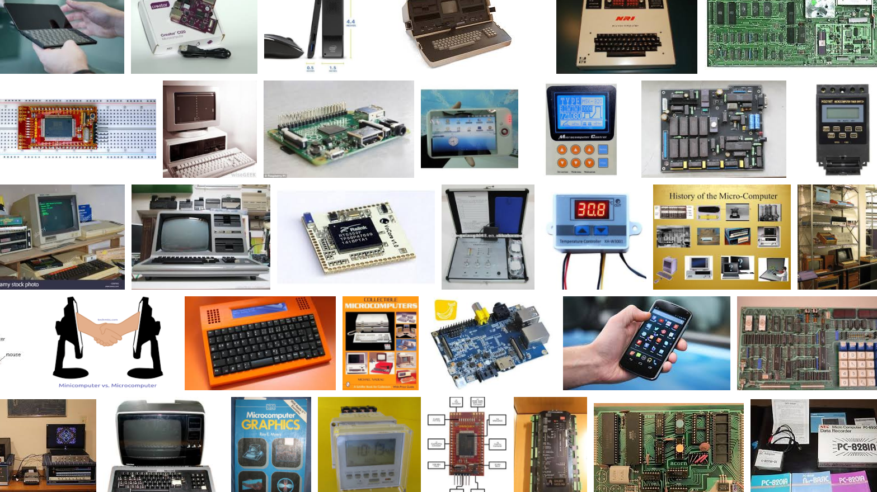
Microservices
https://www.google.co.nz/search?q=micro+computers
&source=lnms&tbm=isch&sa=X&ved=0ahUKEwjew5WuiLnaAhXFabwKHVMJBLEQ_AUICigB&biw=1920&bih=925

Slide 12
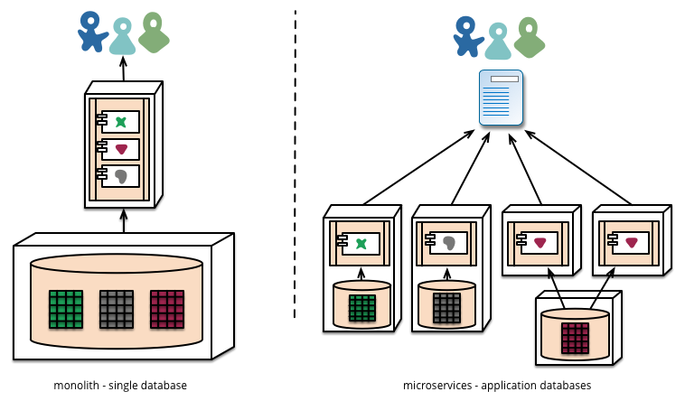

Slide 13
No-containers microservices architecture: example
Custom-built API registry.
Windows services as the services host.
Windows service picks up new DLL/config when they are dropped into a directory.
DLL contains implementation of a WCF service (microservice).
WCF service communication over TCP binding.
Microservice self-registers on the API registry.

Slide 14
Containers microservices architecture: example
“eShopOnContainers”
Code: https://github.com/dotnet-architecture/eShopOnContainers
Book (free): https://aka.ms/microservicesebook
Very comprehensive.

Slide 15
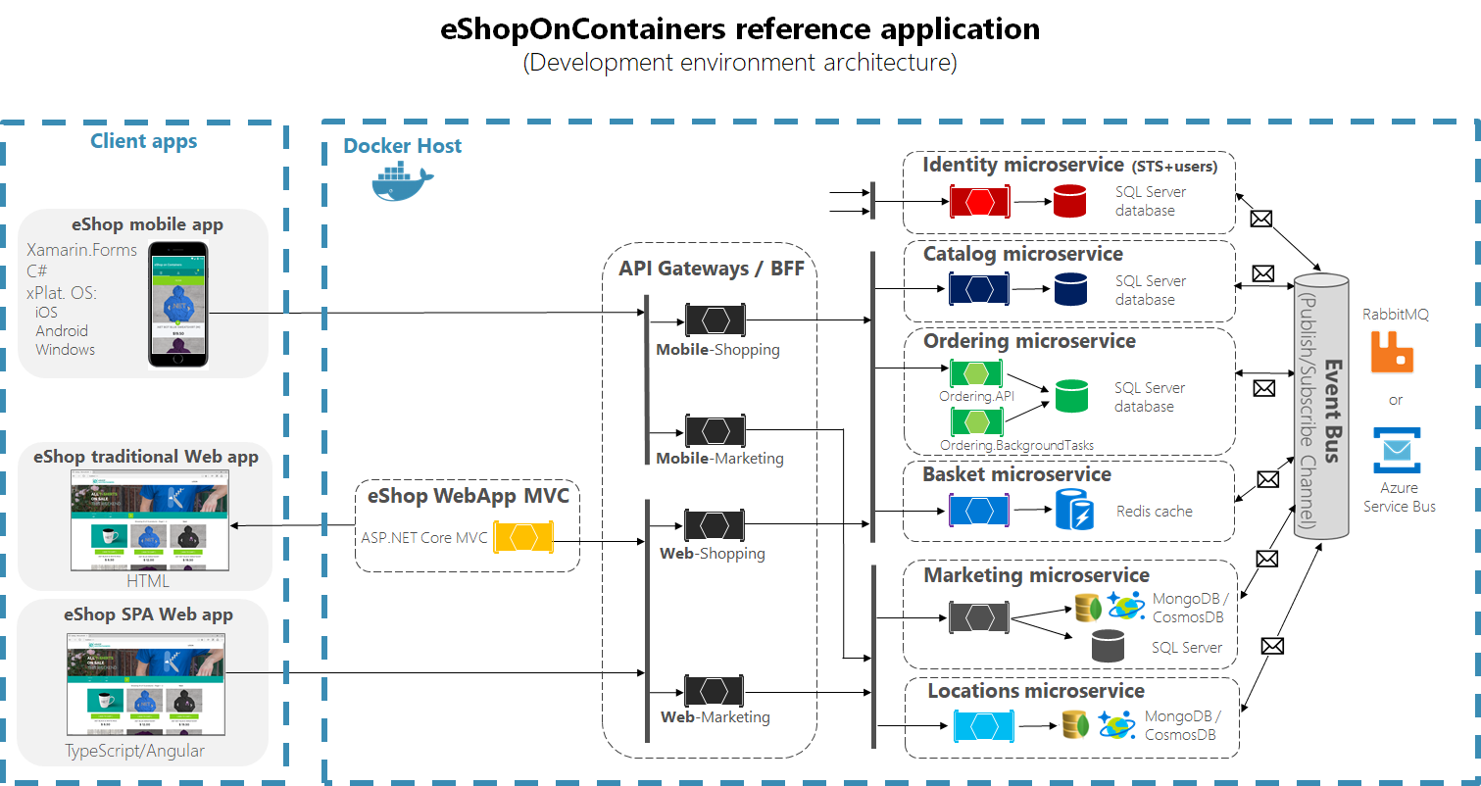

Slide 16
Enabling the Bounded Context pattern…
…for elegant microservice design and data consistency.
Bounded Context comes from DDD; software is developed using language and data definition specific to the domain.
At the same time we want to microservices to be designed for “eventual consistency”; i.e. they are ideally stateless and independent.
Polyglot persistence is OK, and encouraged; i.e. use the right tools and designs for the job – an “Identity” microservice has different persistence needs to a “Basket” microservice.

Slide 17
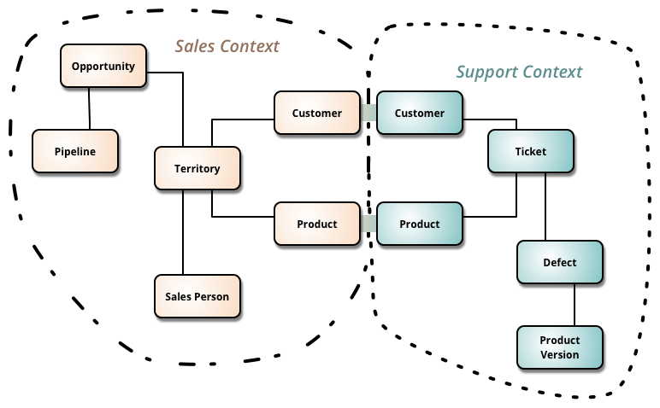
User
Implementation
https://martinfowler.com/bliki/BoundedContext.html

Slide 18
Inter-microservice comms…
…when queries return data from several microservices.
Materialised View pattern – assemble single RO view from multiple microservices prior to request.
API gateway, can have multiple gateways, one per business area, spanning microservices, but a single gateway can create a bottleneck.
Be prepared to refactor – lots of inter-microservice comms may indicate suboptimal design.
A message queue (like RabbitMQ) can guarantee delivery of messages and ensure eventual consistency.

Slide 19
Dos and don’t for microservices (IMO)
Microservices can help when:
Your application needs to scale significantly.
You’re keen to bring dev/test/infra teams closer together.
Don’t go with microservices just yet if:
You’re getting started – start simple, refactor toward microservices, if necessary/desirable.

Slide 20
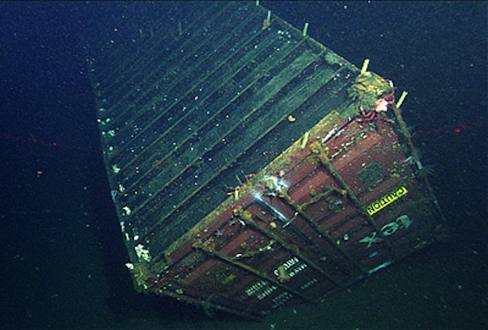
Containers
https://www.livescience.com/45657-shipping-containers-lost-at-sea.html

Slide 21
2017: AKS
2016: Windows Docker Containers
2014: Kubernetes
2013: Docker
2013: LMCTFY
20011: Warden
2008: LXC
2006: Process Containers
2005: Open VZ (Open Virtuzzo)
Containers timeline →
2004: Oracle Solaris Containers
2001: Linux VServer
2000: FreeBSD Jails
1979: Unix V7
https://blog.aquasec.com/a-brief-history-of-containers-from-1970s-chroot-to-docker-2016

Slide 22
Docker
Docker is a commercial product; Docker platform is built on OSS (Moby project).
There are two editions of Docker – Docker Community Edition (CE) and Docker Enterprise Edition (EE).
Docker for Windows (D4W) is CE and runs off of a Linux machine that runs on Windows Hyperviser (Called MobyLinuxVM) that is setup as part if the installation process.
D4W can switch between running Linux containers and Windows containers.
For Linux containers D4W enables direct calls to Docker CE on MobyLinuxVM.
Docker compose can be used to launch and run collections of Docker images in an orchestrated manner.
Docker essentially behaves like a miniature data centre running on your machine.

Slide 23
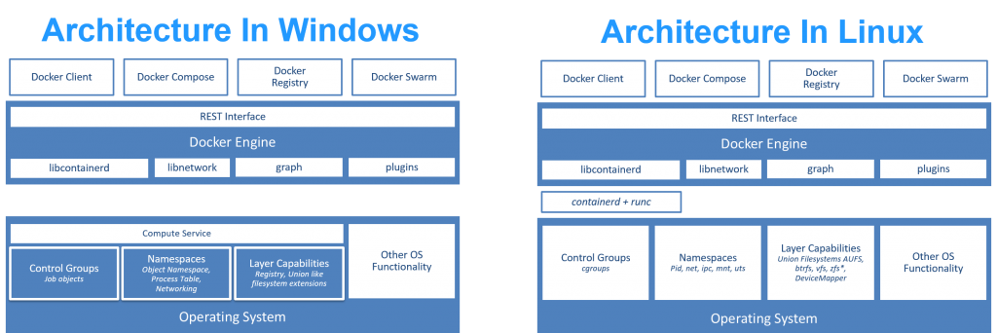
Docker Architecture
http://blog.xebia.com/
deep-dive-into-windows-server-containers-and-docker-part-2-underlying-implementation-of-windows-server-containers/

Slide 24

https://docs.docker.com/engine/docker-overview/

Slide 25
“Dockerisation”
Almost any software that can run on Windows or Linux can be turned into a Docker container.
Other than the client, there are three main parts to Docker:
Docker compose – run multi-container solutions.
Docker registry – where Docker images are kept.
Docker swarm – an inbuilt orchestrator.
Docker Hub can be used to store repositories of Docker images.
SQL Server 2017 seems to be designed to be Dockerised on Linux.

Slide 26
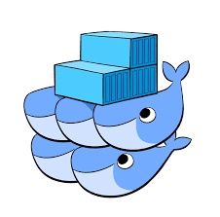
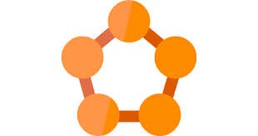
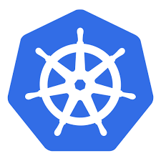

Orchestrators
Docker Swarm
Azure Service Fabric
Kubenetes

Slide 27
Kubernetes (K8s)
Has emerged as the apparent frontrunner of orchestrators.
OSS, created by Brendan Burns (who now works with Microsoft) at Google.
KubeCtrl is a local version of K8s that can be used similar to Docker CE for development purposes.
Options for running K8s on Azure are:
OpenShift (Linux only containers – managed service).
AKS (Linux only containers – managed service).
ACS (Linux and Windows containers – but DIY management and config).

Slide 28
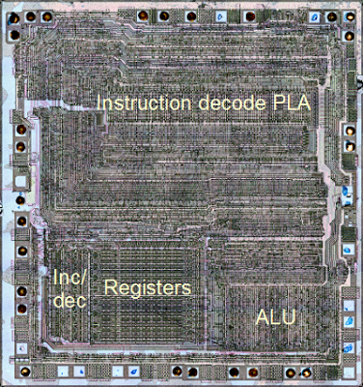
.NET Core
http://www.righto.com/2013/09/the-z-80-has-4-bit-alu-heres-how-it.html

Slide 29
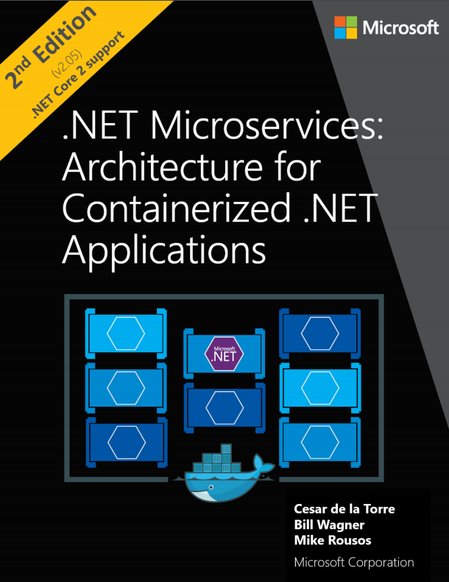
https://aka.ms/microservicesebook

Slide 30
The .NETs
.NET Core is cross platform native, so we can run it on Linux and Windows containers irrespectively. So it’s good for containers.
.NET Core is *purportedly faster than .NET Framework for most things.
.NET Standard replaces Portable Class Libraries – it can be used to communicate between .NET Framework and .NET Core apps.
.NET Framework is the same-as-ever and in a nutshell, should be used if you want to access OS level resources.

Slide 31
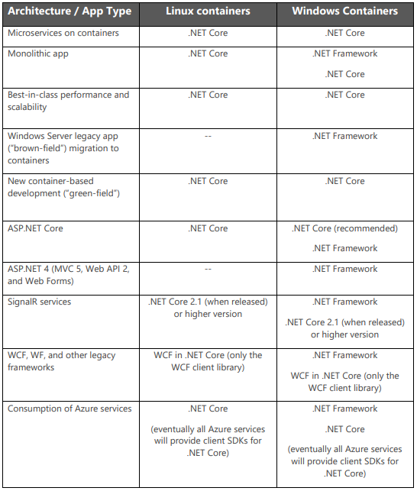

Slide 32
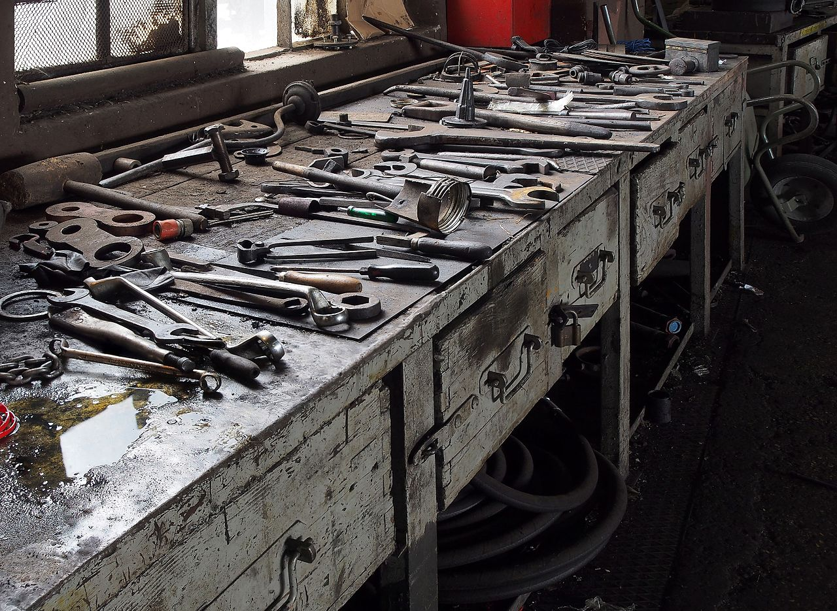
Workshop
https://en.wikipedia.org/wiki/Workshop#/media/File:Railway_workshop_museum_exhibition_in_Ljubljana,_Slovenia.jpg

Slide 33
References
Docker platform overview: https://docs.docker.com/engine/docker-overview/#the-docker-platform
Docker swarm: https://docs.docker.com/engine/swarm/
Docker registry: https://docs.docker.com/registry/
Docker compose: https://docs.docker.com/compose/overview/
Docker commands: https://docs.docker.com/engine/reference/commandline/docker/
Fowler on microservices: https://martinfowler.com/microservices/
What are microservices (article that’s not TL;DR): https://blog.restcase.com/what-are-microservices/
Fowler on serverless: https://martinfowler.com/articles/serverless.html
.NET Standard: https://docs.microsoft.com/en-us/dotnet/standard/net-standard
Moby project: https://github.com/moby
eShopOnContainers code: https://github.com/dotnet-architecture/eShopOnContainers
eShopOnContainers book (free): https://aka.ms/microservicesebook
Creator of Kubernetes: https://architecht.io/kubernetes-creator-brendan-burns-on-joining-microsoft-and-where-were-really-at-with-containers-ac7d496911af
Docker Hub (free to sign-up and use): https://hub.docker.com/

